Slide 1

IMMUNONUTRIZIONE
O CHETOSI:
Quale migliore alleato nel
pre-opeatorio
Farnaz Rahimi
Dirigente Medico
Responsabile centro obesità e
chirurgia bariatrica
SC di Dietetica e Nutrizione Clinica
AUO Città della Salute e della Scienza di Torino (Ospedale Molinette)

Slide 2
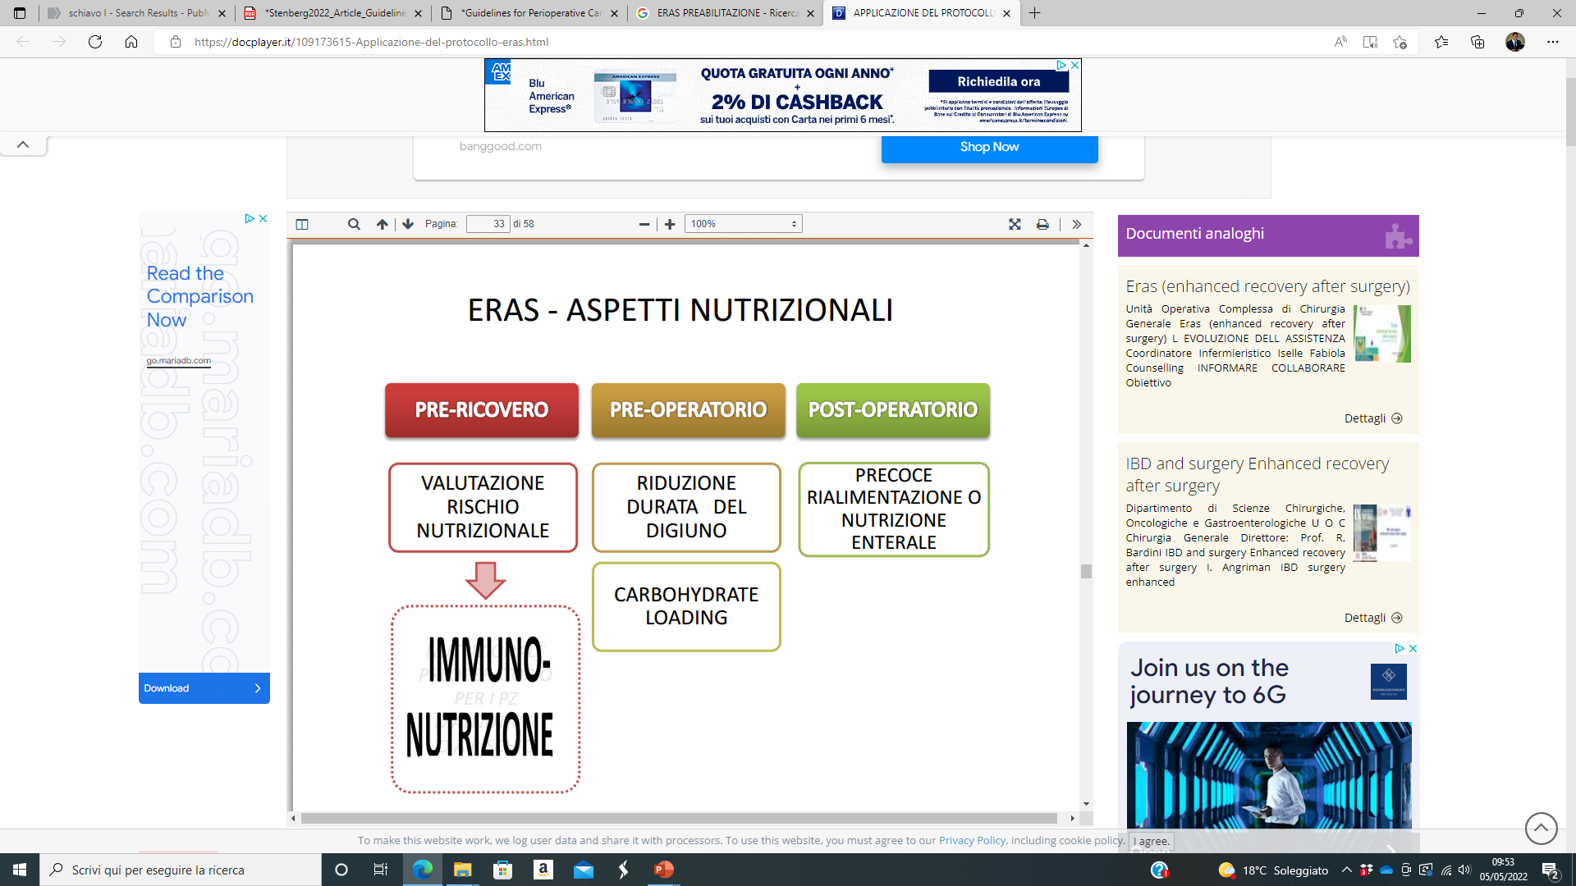

L'immunonutrizione preoperatoria, che prevede la somministrazione di nutrienti specifici, ha dimostrato di:
ridurre le complicanze postoperatorie, in particolare quelle infettive
abbreviare la degenza ospedaliera in pazienti sottoposti a chirurgia addominale maggiore.
CHIRURGIA METABOLICA E BARIATRICA ?

Slide 3
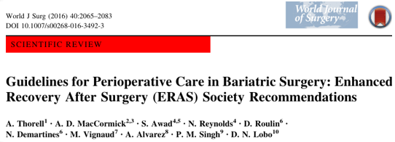
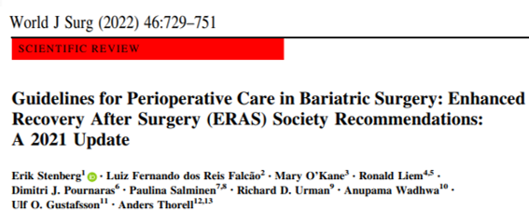
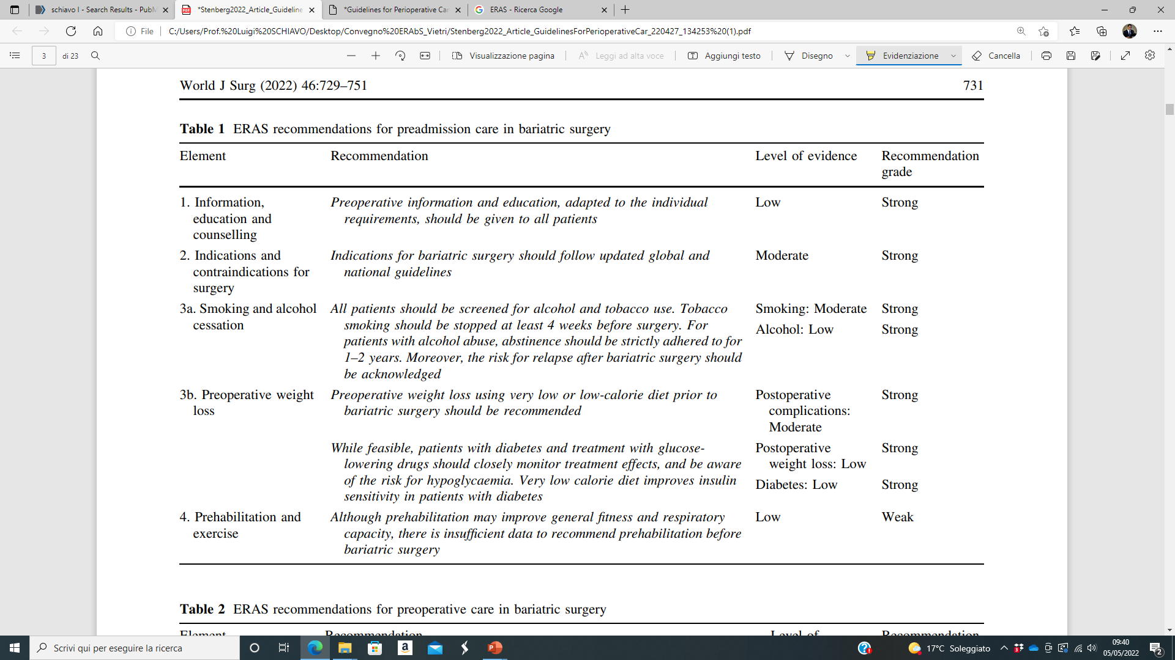

Slide 4
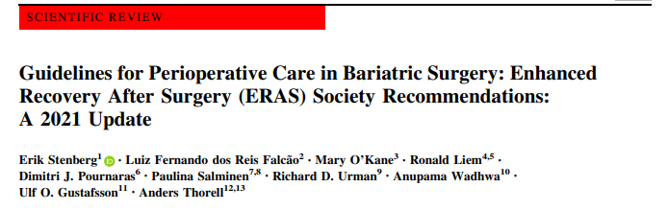
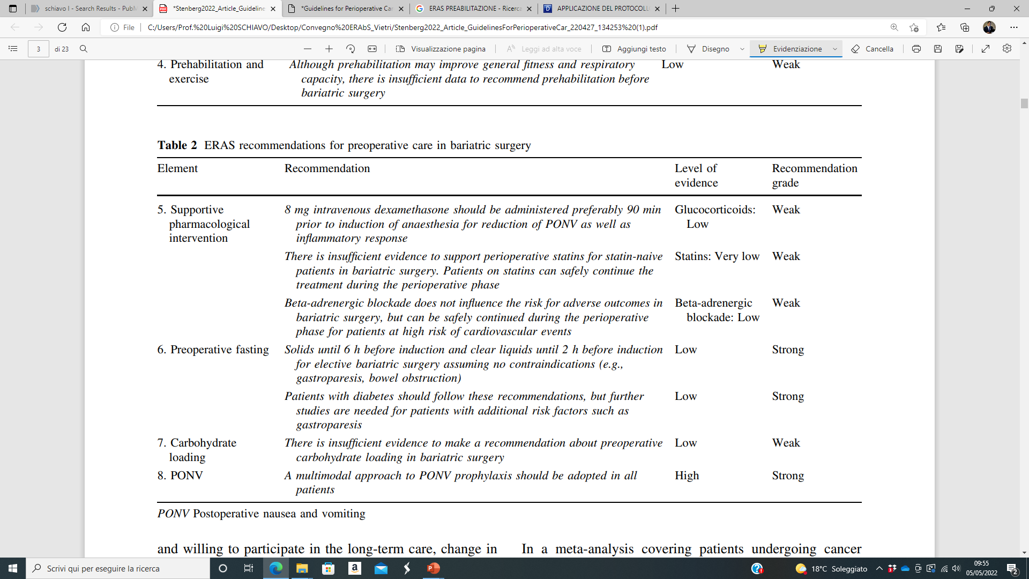

Slide 5
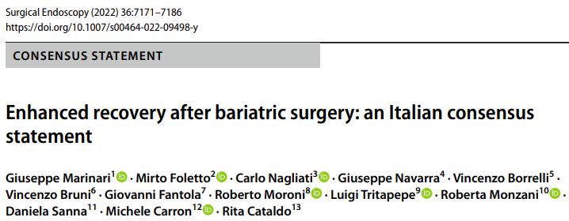

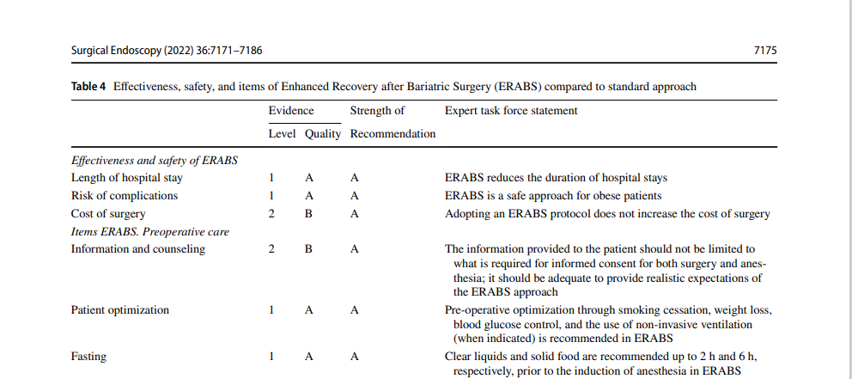
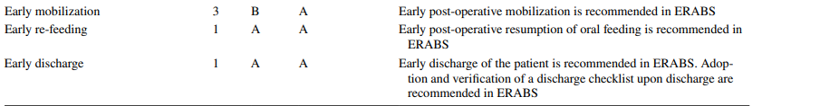

Slide 6
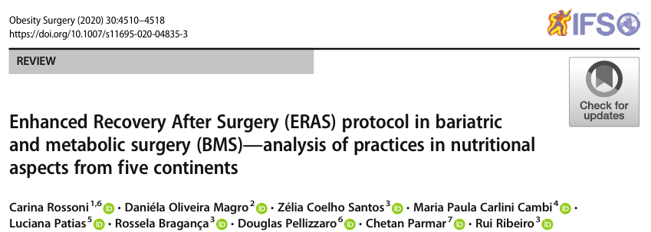
This study aims to understand the prevalent practices on the nutritional aspects of the ERABS worldwide
Only surgeons, nutritionists, and anesthesiologists (five continents: Africa, America, Asia, Europe, and Oceania) were invited to participate
An electronic questionnaire was provided to evaluate practices about the three nutritional aspects of ERABS protocol:
preoperative fasting
carbohydrate loading
early postoperative nutrition

Slide 7
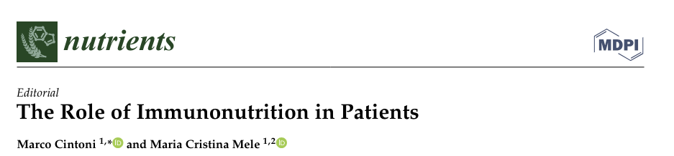
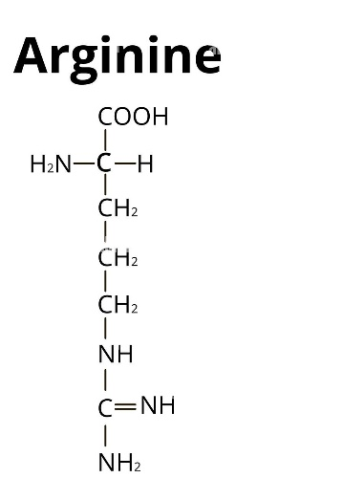
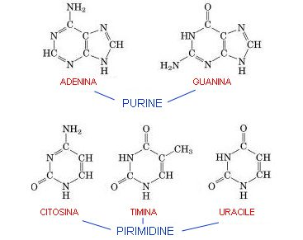
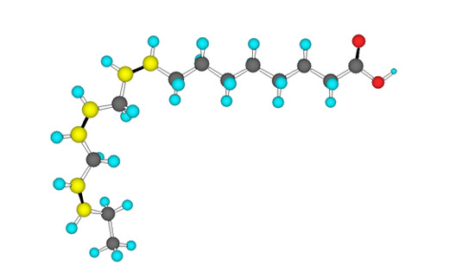
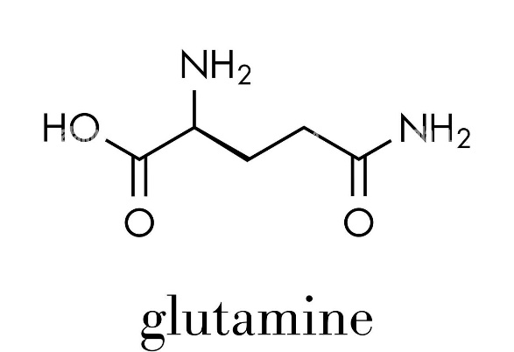
Immunonutrition (IN) is defined as “the use of specific nutritional substrates, called «immunonutrients» having the ability of modulating specific mechanisms involved in several immune and inflammatory pathways”
The most studied immunonutrients are:
Acidi grassi omega-3
Nucleotidi

Slide 8
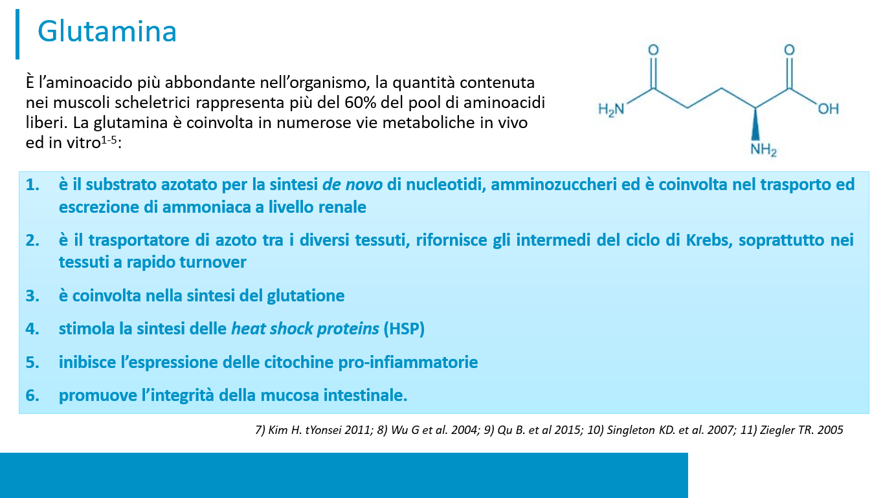

Slide 9
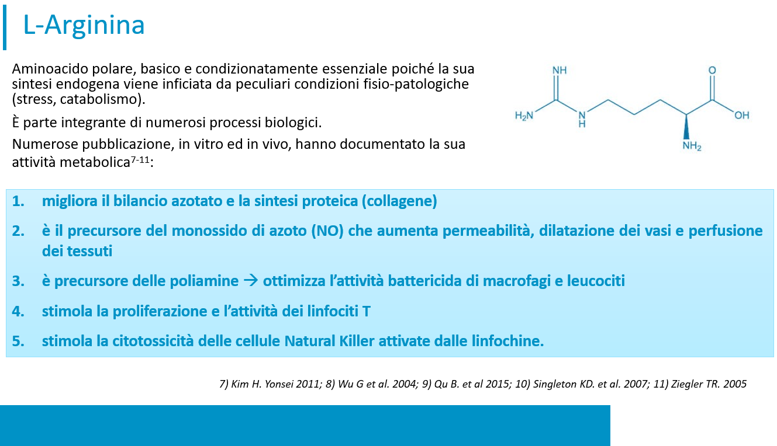

Slide 10
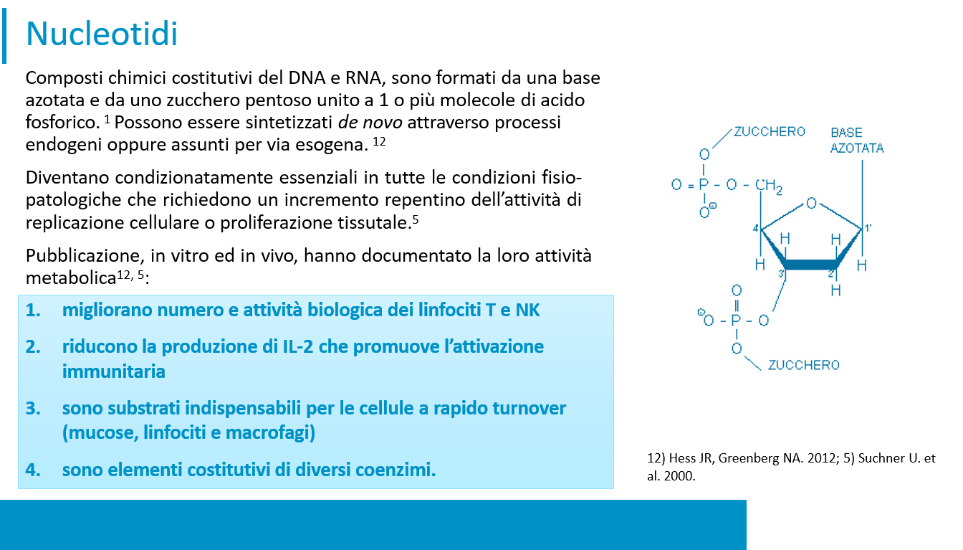

Slide 11
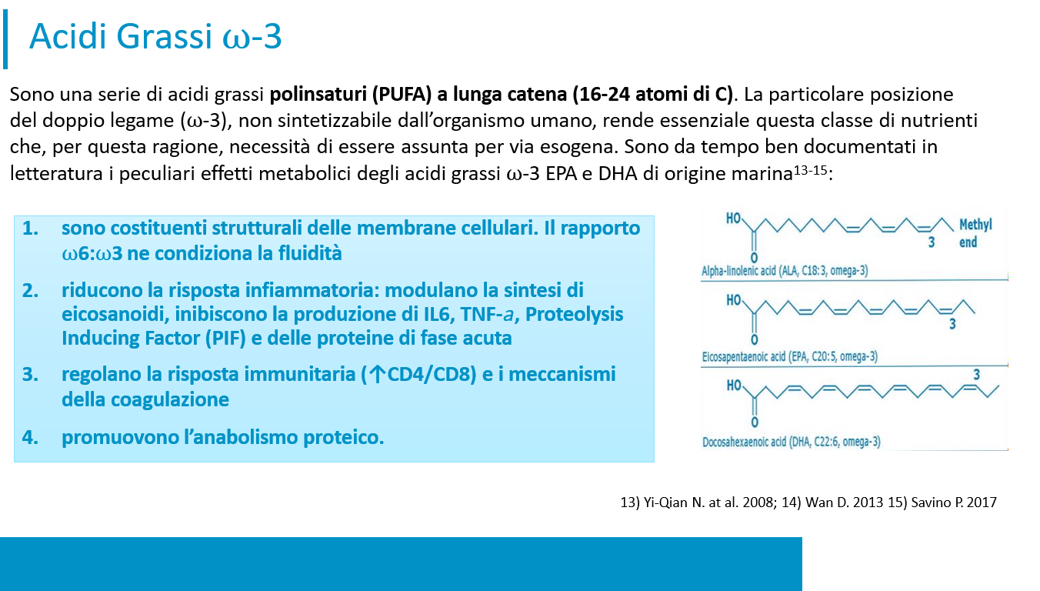

Slide 12
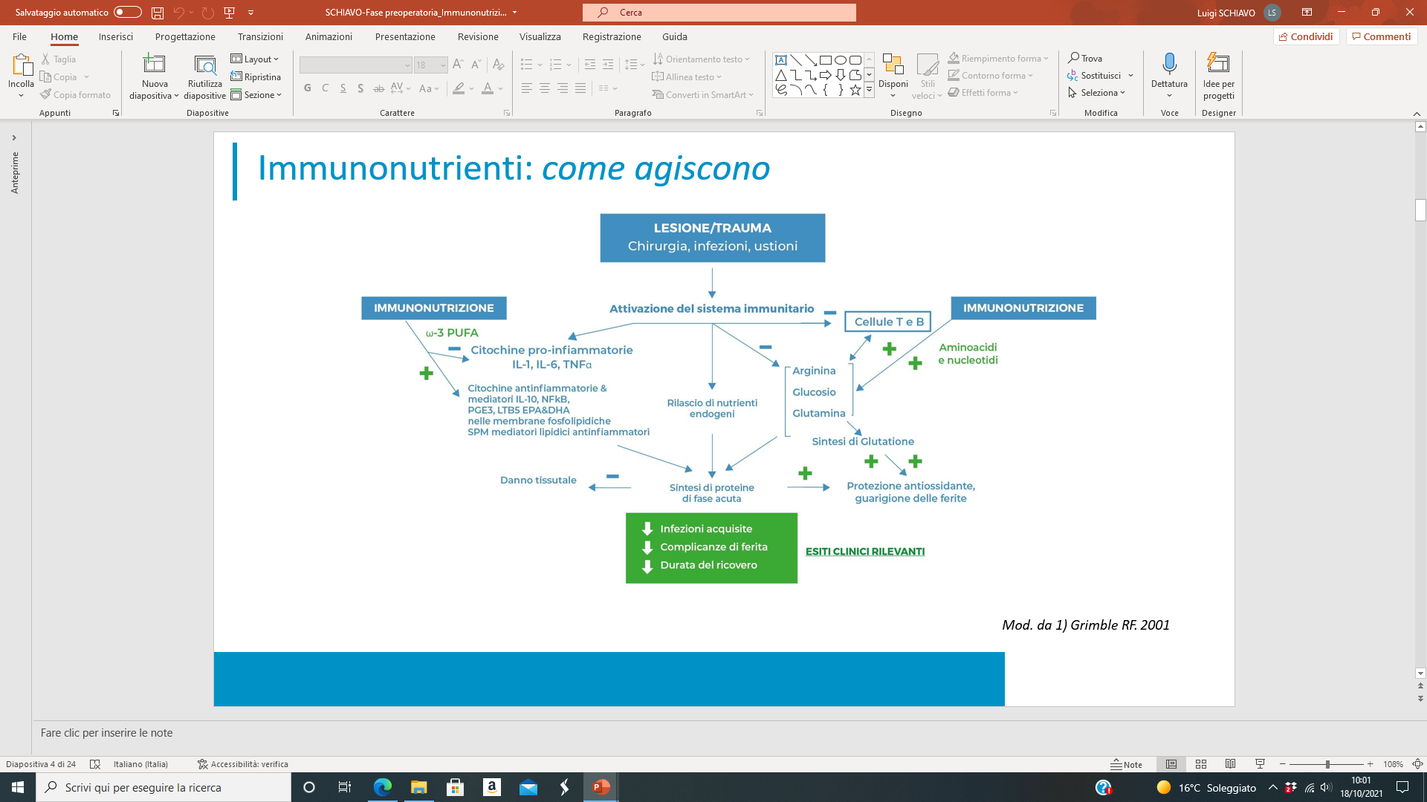

Slide 13
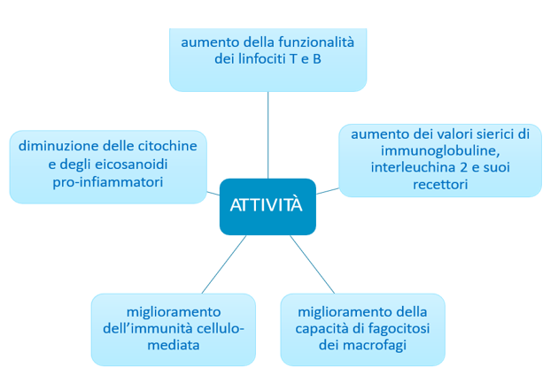
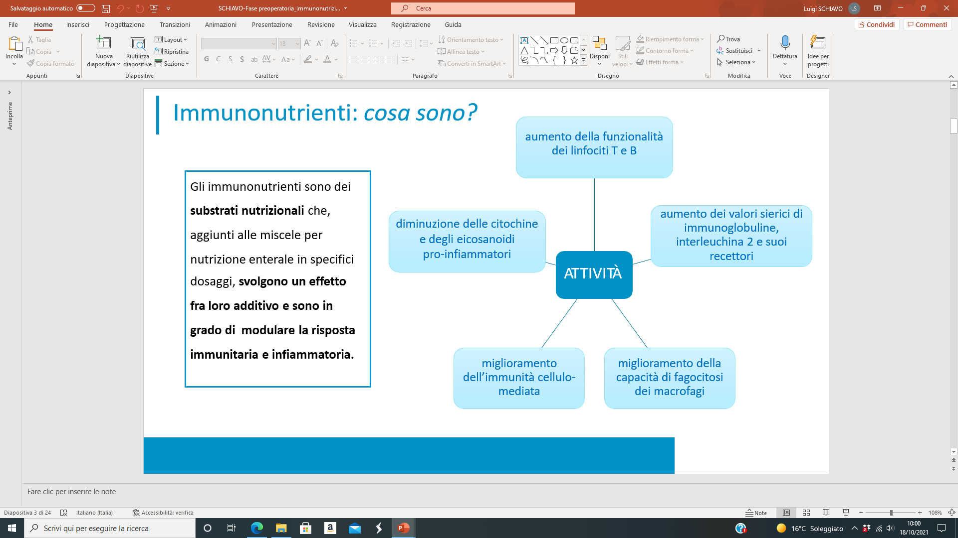

Slide 14
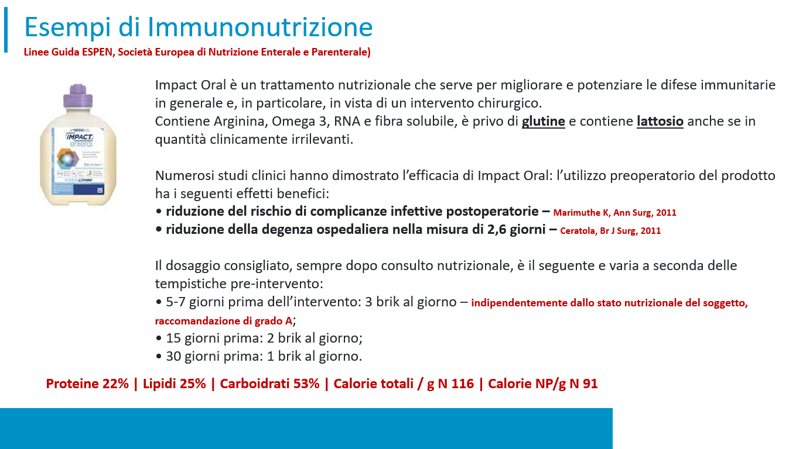

Slide 15
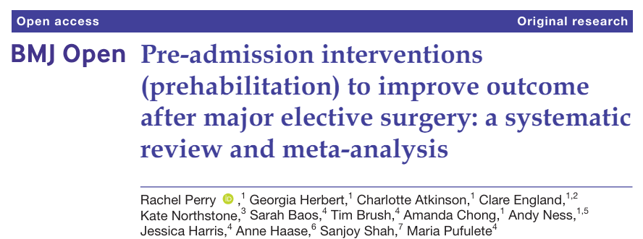
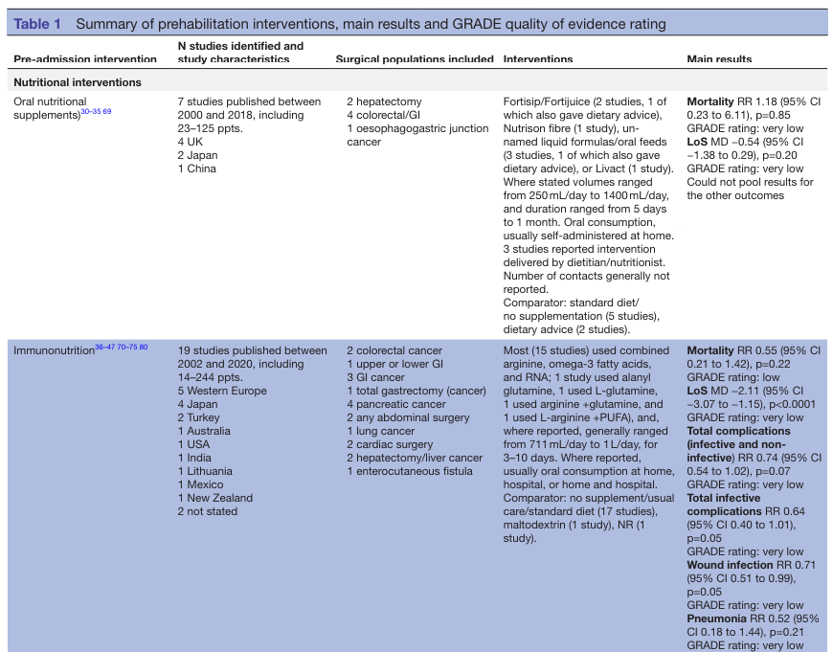
2021;11:e050806
No Metabolic and Bariatric Surgery

Slide 16
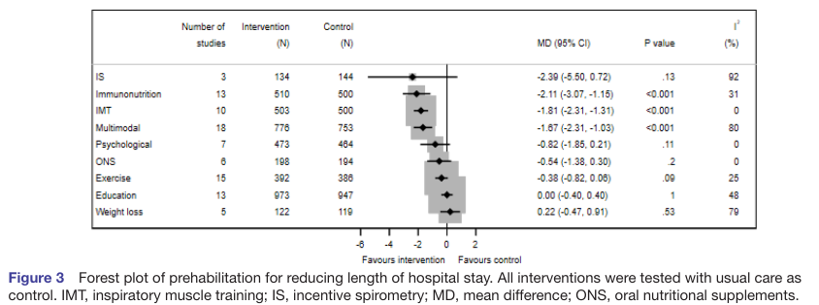
Immunonutrition reduces length of hospital stay of 31%

Slide 17
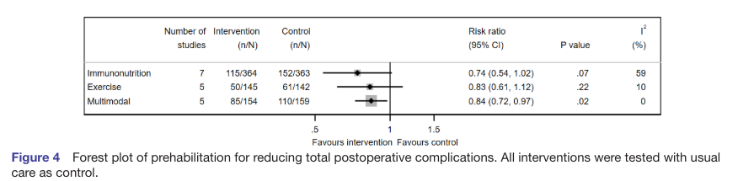
Immunonutrition reduces total postoperative complications
(infective and non-infective) of 59%

Slide 18
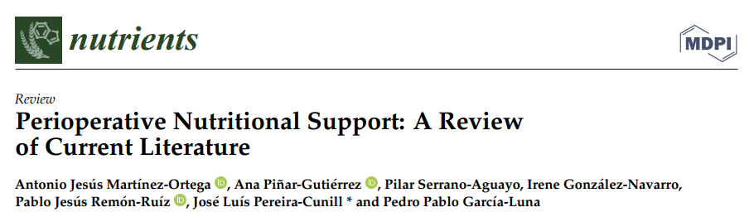
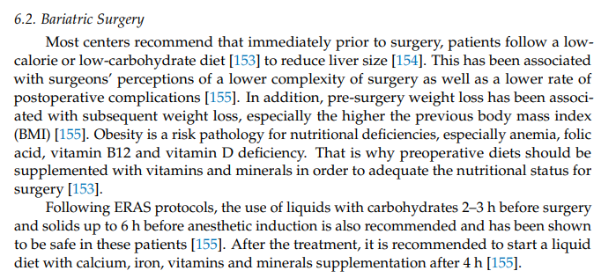
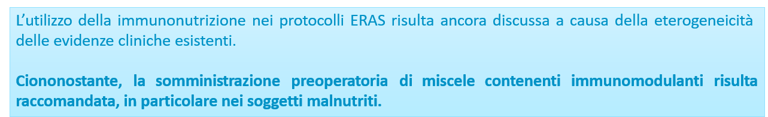
No Recommendations concerning the use of Immunonutrition before Metabolic and Bariatric Surgery was made

Slide 19
Conclusions.
ERABS is an effective and safe approach
ERABS reduces the length of hospital stay and does not heighten the risk of major post-operative complications, re-operations, and hospital re-admissions, nor does it increase the overall surgical costs

Slide 20
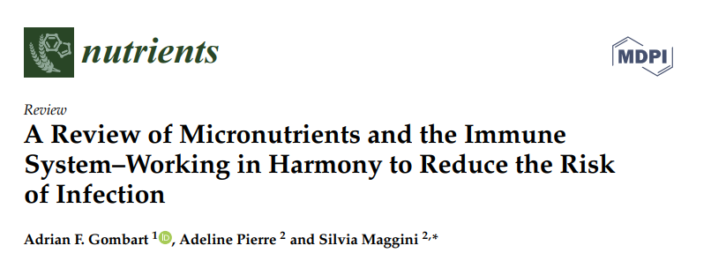
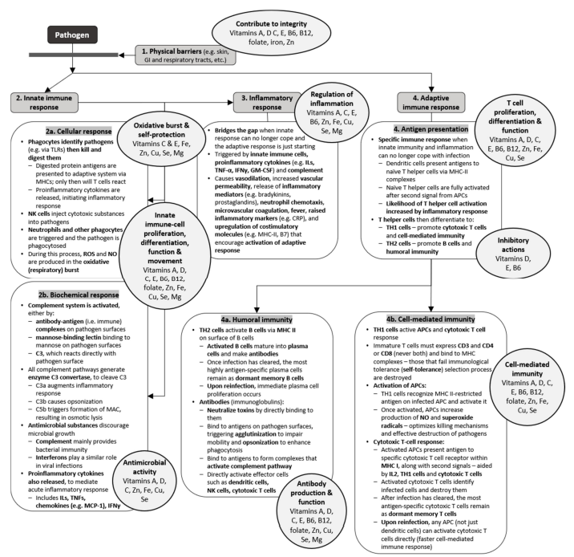

Slide 21
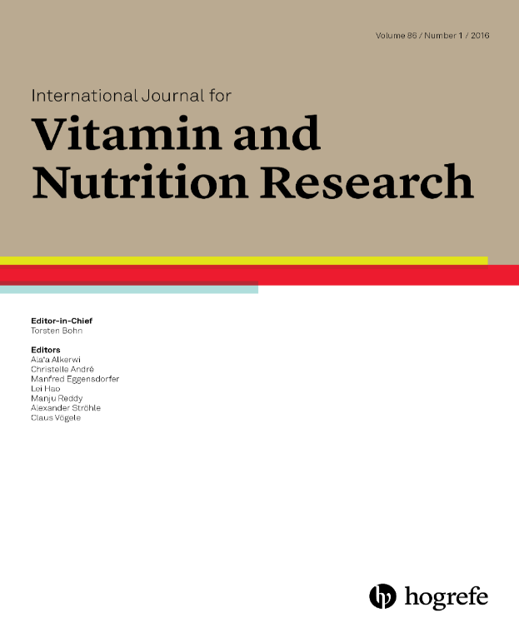
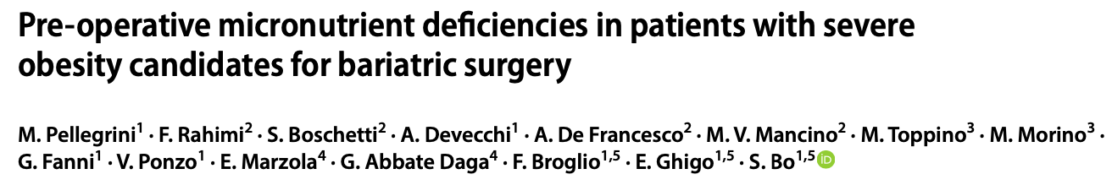
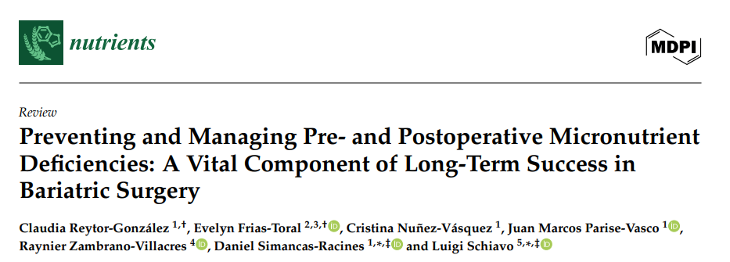
Between 35-80% of bariatric candidates are, PARADOXALLY, in a state of “HIGH CALORIE MALNUTRITION” and shows some dietary deficiency pre-operatively
Identify and Correct micronutrient deficiencies in sufficient time before bariatric surgery

Slide 22
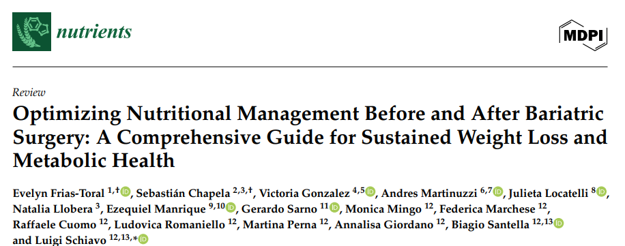
Nutritional management prior to surgery is essential to achieve metabolic control and optimize the patient clinical status before surgery to reduce the potential comorbidities associated with the procedure.

Slide 23
CHEOSI PREINTERVENTO

Slide 24
BENEFICI DELLE VLCKD/VLEKT PRE-CHIRURGIA BARIATRICA
RAPIDITA’ CALO PONDERALE
RIDUZIONE GRASSO VISCERALE
Nutrients 2023; 15:1907
Obes Surg 2019; 29:292
Rev Endocr Metab Disord 2020; 21:297
Nutrients 2022; 14:2610
MINORI PERDITE DA DRENAGGI E ANEMIA
RIDUZIONE VOLUME EPATICO
VLCKD
VLEKT
RIDUZIONE DEGENZA OSPEDALIERA
RIDUZIONE TEMPO OPERATORIO?
CORREZIONE CARENZE VITAMINE MINERALI
RIDUZIONE INFIAMMAZIONE

Slide 26
EVIDENZE PER LED/VLED
TEMPO OPERATORIO
COMPLICANZE POST-OP

Slide 27
The main indications for the use of VLCKD/VLEKT in obesity are:
-severe obesity,
-treatment of obesity with bariatric indications in the preoperative period before the bariatric procedure,
-sarcopenic obesity,
-obesity associated with hypertriglyceridemia and/or hypertension and/or type 2 diabetes and/or metabolic syndrome and/or NAFLD and/or obstructive sleep apnea syndrome and/or bone diseases or severe arthropathy

Slide 28
Absolute contraindications:
type 1 diabetes mellitus, latent autoimmune diabetes in adults, β-cell failure in type 2 diabetes mellitus,
use of sodium/glucose cotransporter 2 (SGLT2) inhibitors (risk of euglycemic diabetic ketoacidosis),
pregnancy and breastfeeding,
kidney failure and severe chronic kidney disease,
liver failure,
hearth failure (NYHA III–IV), respiratory insufficiency, unstable angina, a recent stroke or myocardial infarction (<12 months), cardiac arrhythmias,
eating disorders and other severe mental illnesses, alcohol and substance abuse,
active/severe infections,
frail elderly patients,
48 h prior to an elective surgery or invasive procedures and a perioperative period,
rare disorders such as porphyria, carnitine deficiency, carnitine palmitoyltransferase deficiency, carnitine-acylcarnitine translocase deficiency, mitochondrial fatty acid β-oxidation disorders, and pyruvate carboxylase deficiency

Slide 29
EFFETTI AVVERSI
COLELITIASI
UROLITIASI
DISIDRATAZIONE
DISIONIE
IPER-URICEMIA
IPOGLICEMIA TRANSITORIA
VLCKD
VLEKT
DIGIUNO
CADUTA CAPELLI
ALITOSI
STIPSI
DIARREA
NAUSEA
VOMITO

Slide 32
Remember that your lowest weight post-surgery will occur between 12 to 18 months. After this, there is a natural increase in weight that occurs. If you are gaining excessive amounts of weight, discuss this with your bariatric team or primary care provider
Studies that have been conducted in the bariatric surgery population show that significant weight regain (≥ 15% gain of initial weight loss post-bariatric surgery) occurs in 25–35% of people who undergo surgery two to five years after their initial surgical date

Slide 36
CONCLUSIONI E PROSPETTIVE FUTURE
​L'immunonutrizione preoperatoria, che prevede la somministrazione di nutrienti specifici come arginina, acidi grassi omega-3 e nucleotidi, ha dimostrato di ridurre le complicanze postoperatorie, in particolare quelle infettive, e di abbreviare la degenza ospedaliera in pazienti sottoposti a chirurgia addominale maggiore.
Tuttavia, attualmente non esistono studi specifici che valutino l'efficacia dell'immunonutrizione preoperatoria nei pazienti sottoposti a chirurgia bariatrica.
Pertanto, studi sono necessari per avere evidenze specifiche e scientifiche dell’applicabilità e dell’utilità di tale approccio nel paziente candidato a chirurgia bariatrica e metabolica
La strategia VLCKD/VLEKT preoperatoria ha delle evidenze/raccomandazioni di grado A: per la rapidità del calo ponderale e riduzione del grasso viscerale ed epatica, riduzione del tempo opertatorio e la degenza ospedaliera e riduzione dell’infiammazione e la correzione delle carenze di micro nutrienti, di vitamine e della sarcopenia.
La terapia chetogenica risulta utile anche dopo la chirurgia bariatrica con minore tasso di weight regain, in termine di BMI e circonferenza addominale.
Rimane un strumento valido anche in casi di minor successo della chirurgia bariatrica

Slide 37
GRAZIE

